Slide 1
Waterfowl
&
Shorebird Identification
CTS Wildlife

Slide 2
Classifications
All ducks are divided into two categories:
  Puddle Ducks
  Diving Ducks

Slide 3
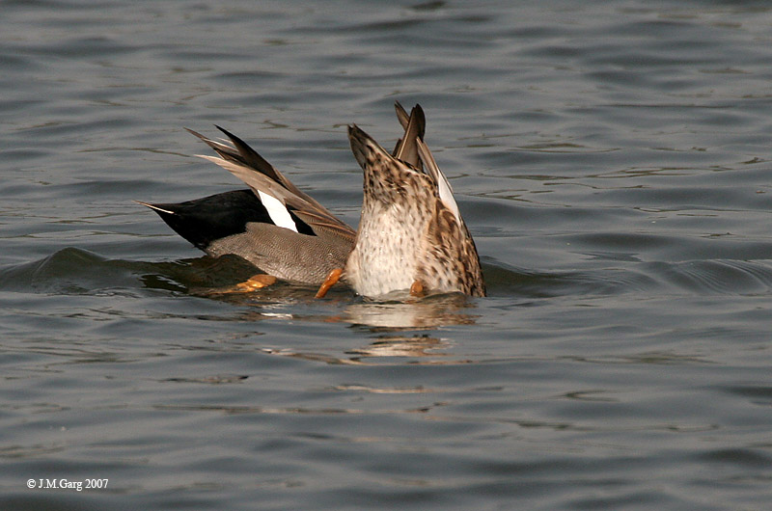
Puddle Ducks
Tip over to feed
Take off straight up off of the water
Their legs are situated more to the middle of their body

Slide 4
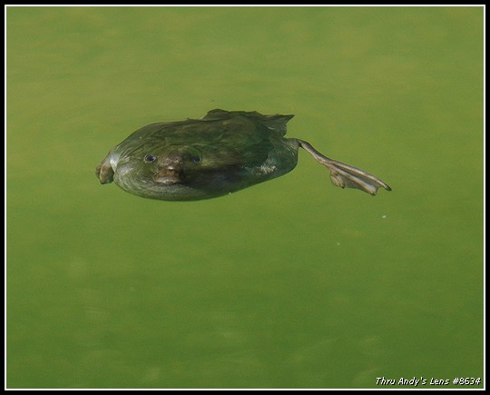
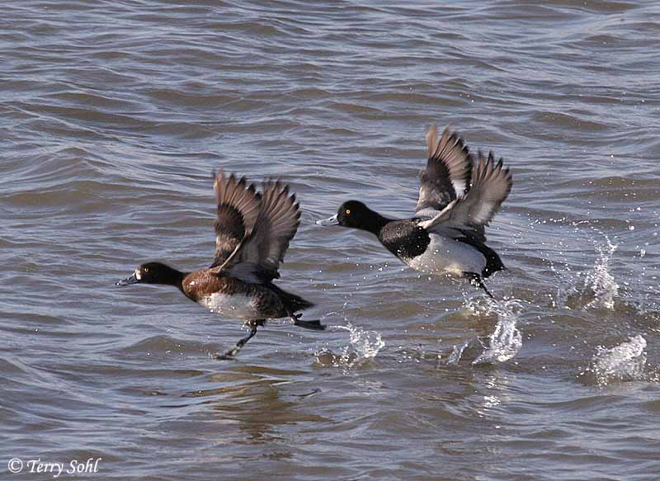
Diving Ducks
Dive for their food (some dive to 10 metres)
Legs are situated near the back of the body
Take off from the water by running along the surface

Slide 5
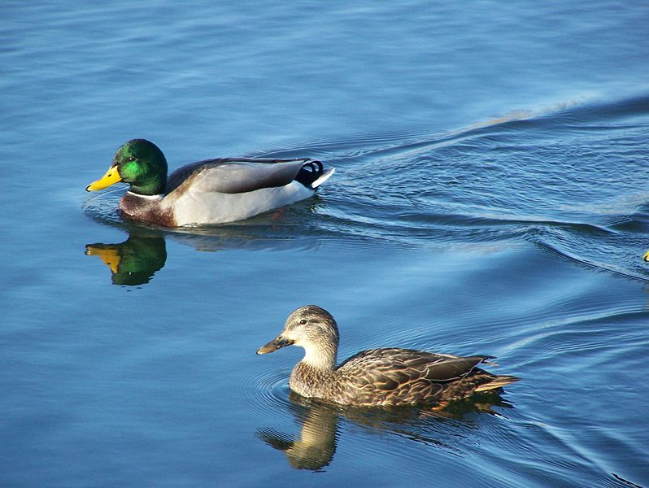
Mallard Duck
Drake (male)
Hen (female)

Slide 6
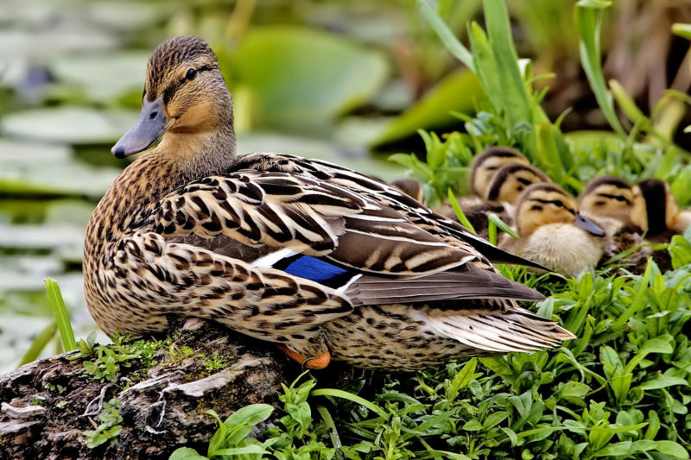
The colored bar on a duck’s wing is called the speculum. Puddle duck speculums are metallic in color.

Slide 7
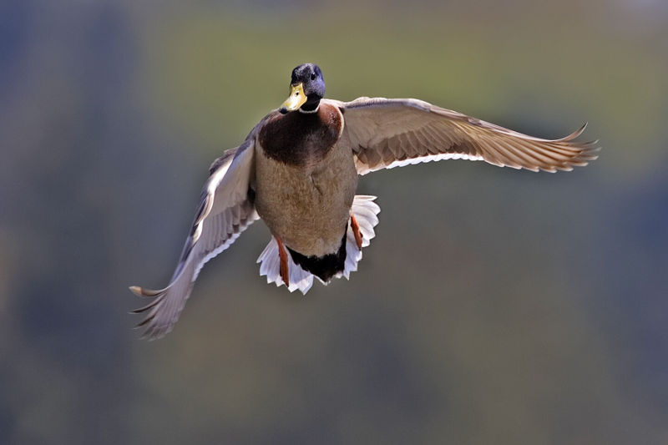

Slide 8
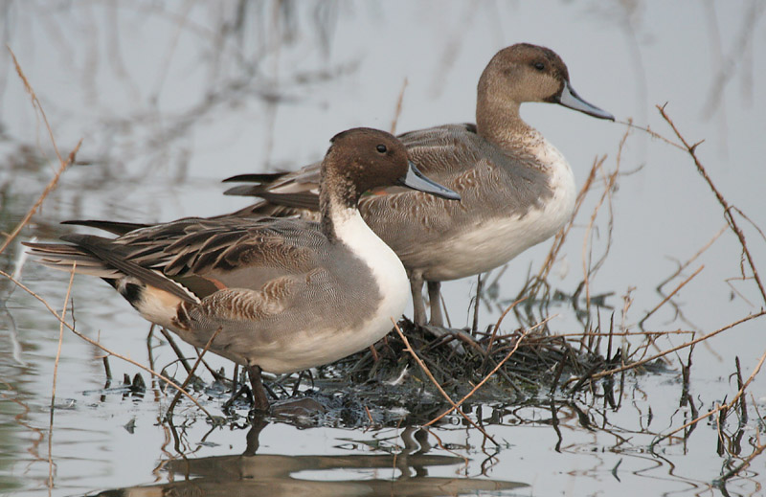
Northern Pintail

Slide 9
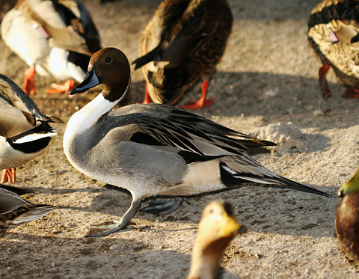

Slide 10
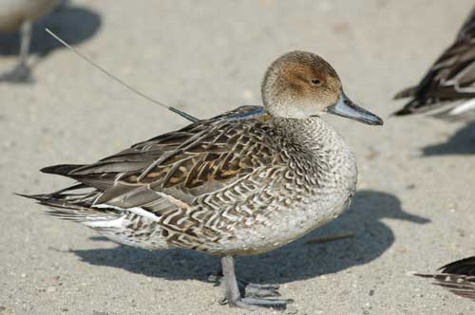
Antenna for implanted radio – used to track nesting habits

Slide 11
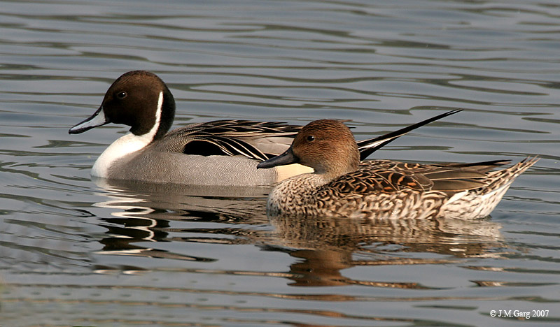
The Pintail is the official duck of Alberta

Slide 12
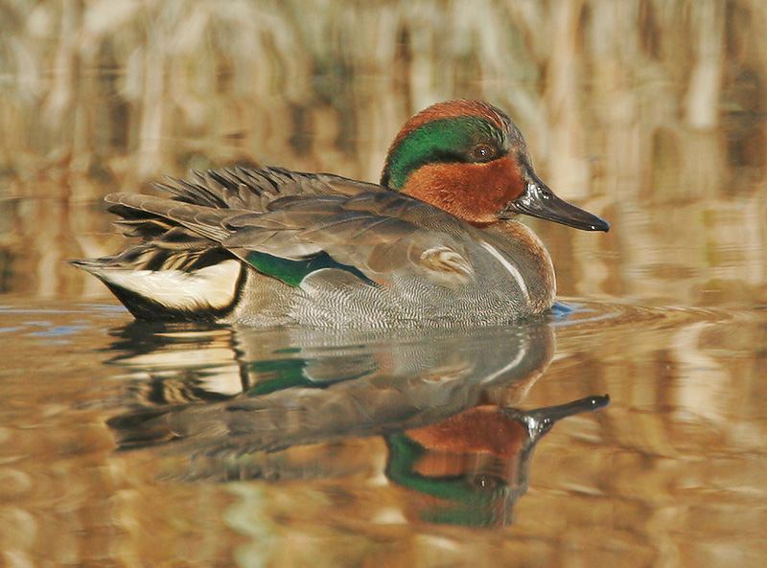
Greenwing Teal

Slide 13
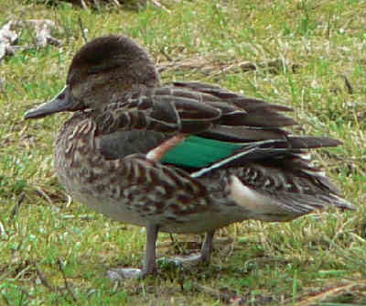

Slide 14
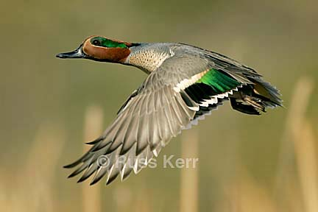

Slide 15
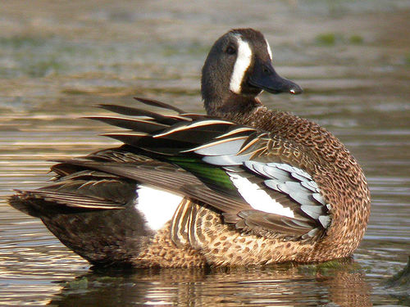
Blue Wing Teal

Slide 16
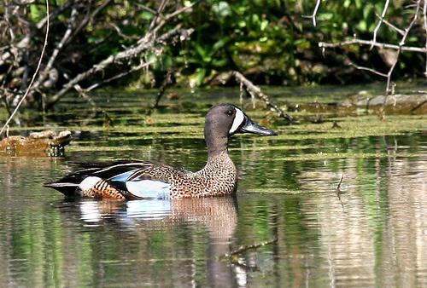
The blue wing teal is actually not a teal, but a close relative of the shoveler.

Slide 17
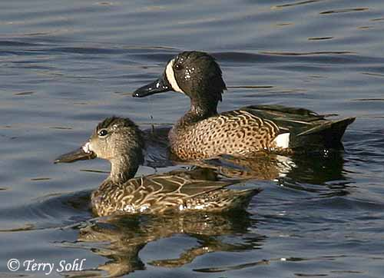

Slide 18
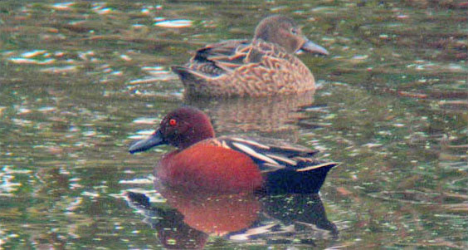
Cinnamon Teal

Slide 19
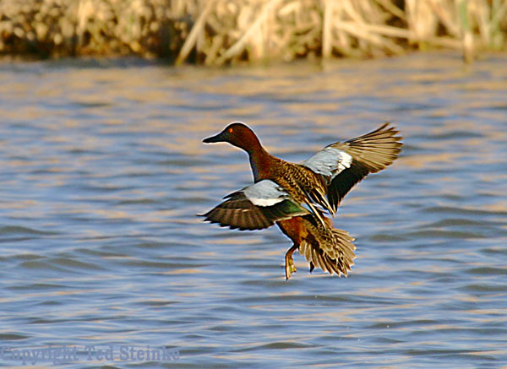

Slide 20
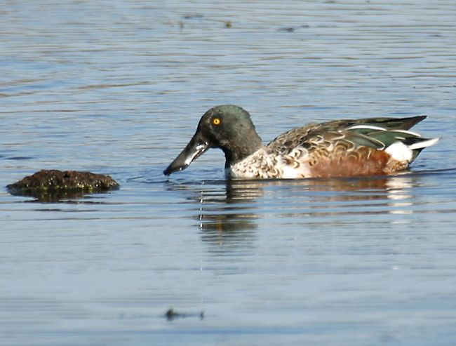
Northern Shoveler

Slide 21
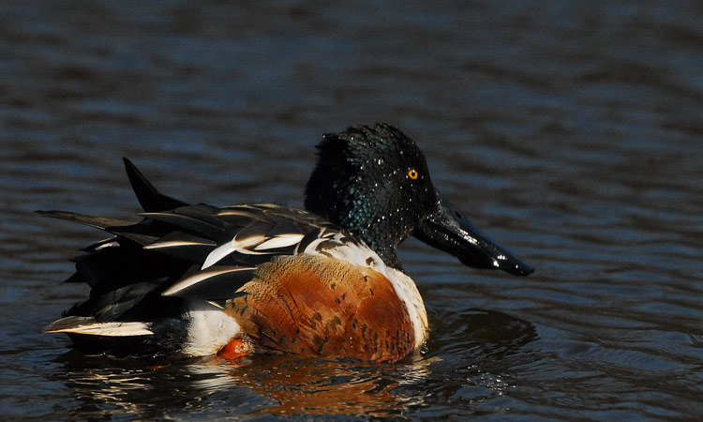
The shoveler’s bill is used to filter small plants, seeds and animals from the water

Slide 22
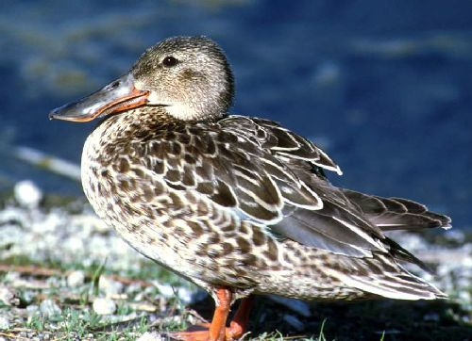

Slide 23
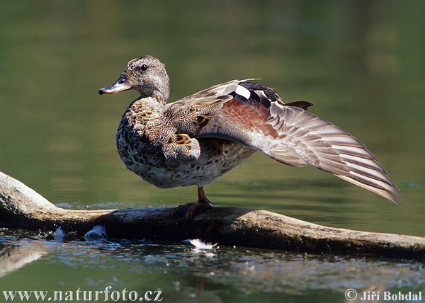
Gadwall

Slide 24
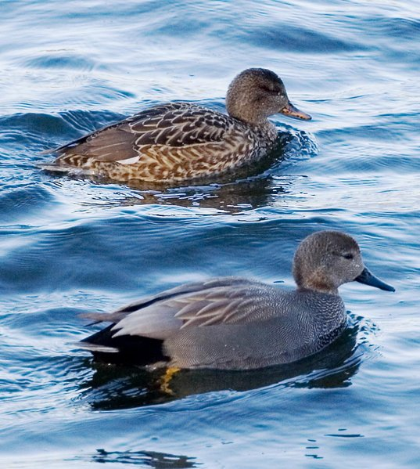
Female
Male

Slide 25
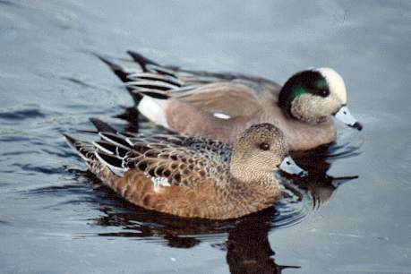
American Widgeon

Slide 26
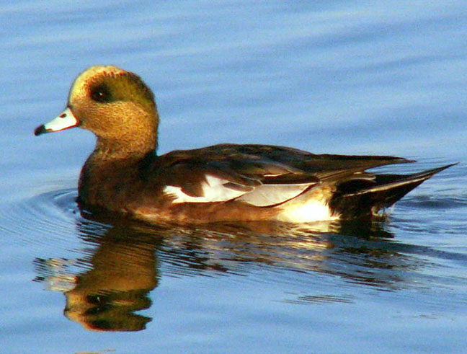
Often referred to as “Baldies” - from bald pate or bald head – because of the light colored feathers on the top of the head give the illusion of baldness

Slide 27
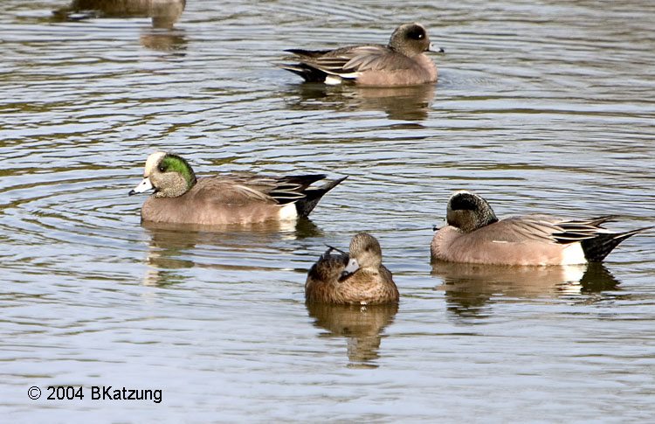

Slide 28
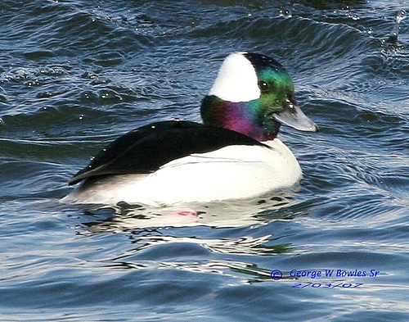
Bufflehead

Slide 29
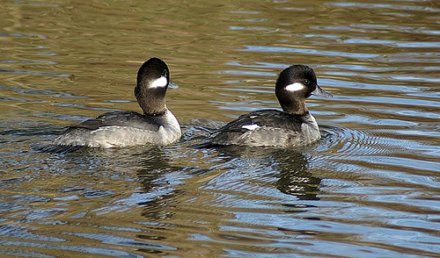
The tails of diving ducks generally sit low in the water. Puddle ducks tails generally stick out of the water while swimming

Slide 30
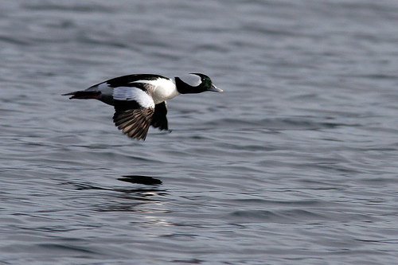

Slide 31
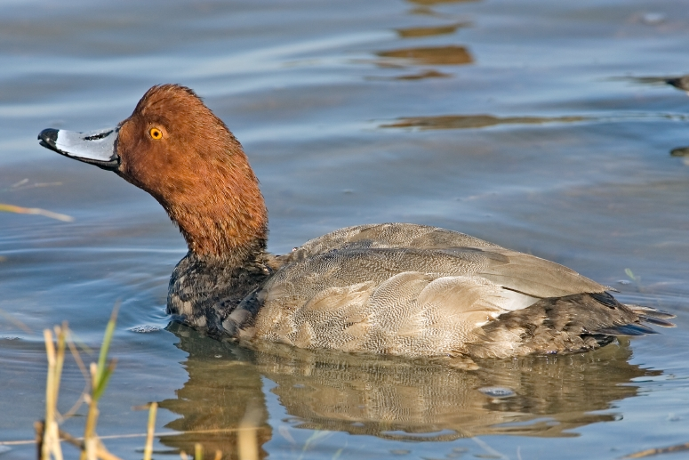
Red Head

Slide 32
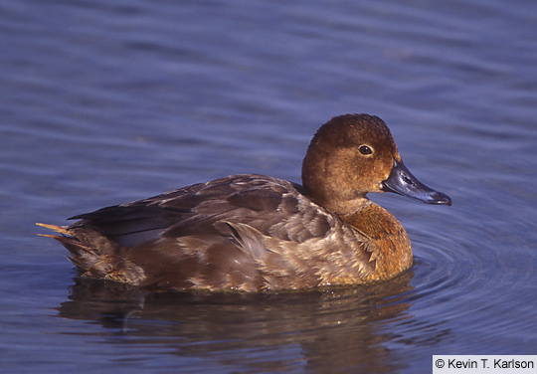

Slide 33
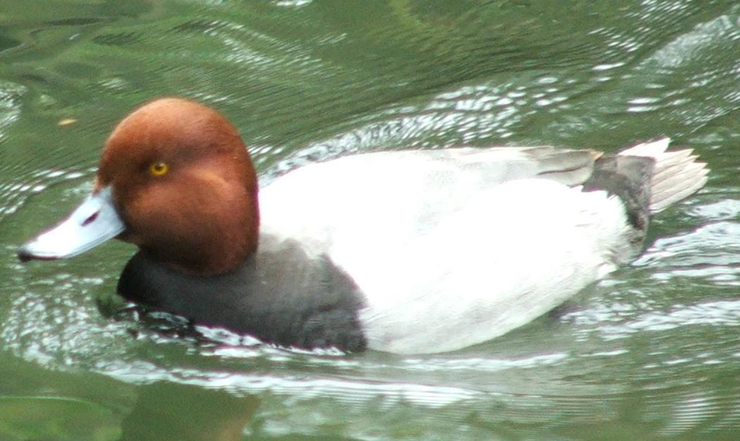

Slide 34
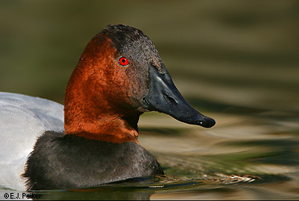
Canvasback
Known as
“The King of Ducks”

Slide 35
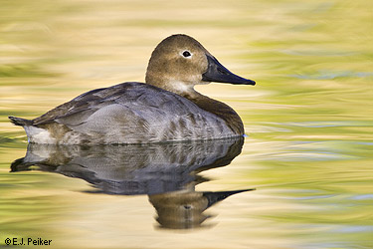

Slide 36
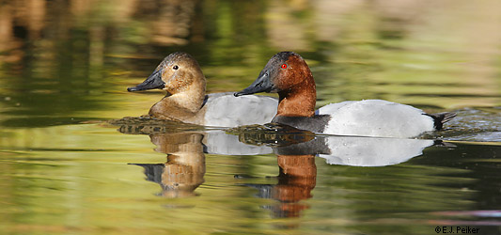

Slide 37
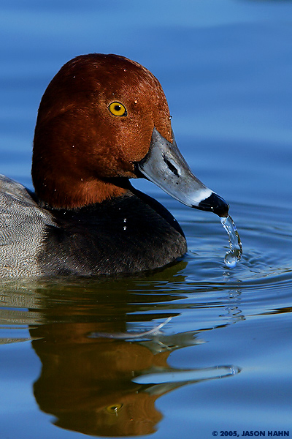
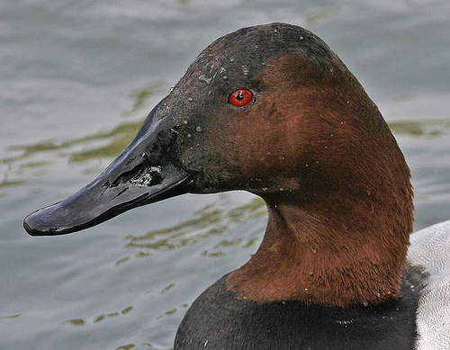
Redhead has rounded head, black bill tip and yellow eyes
Canvasback has wedge shaped head and red eyes.

Slide 38
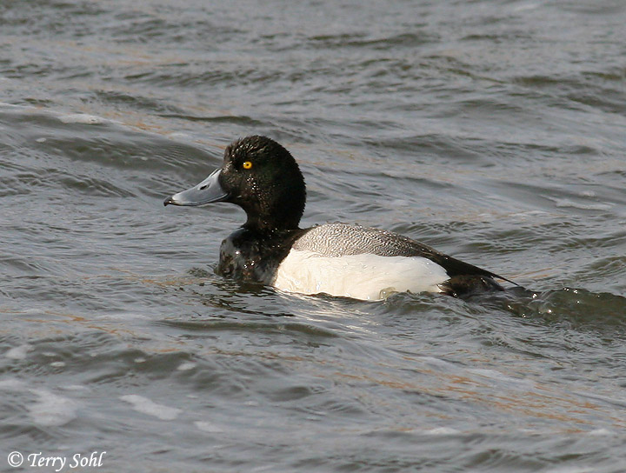
Lesser Scaup
Commonly known as a “bluebill”

Slide 39
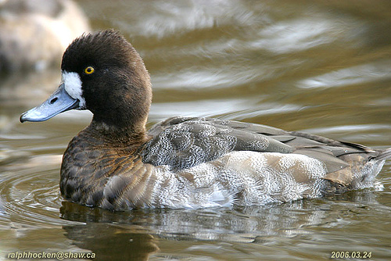

Slide 40
Example of how diving ducks take off by running across the water

Slide 41
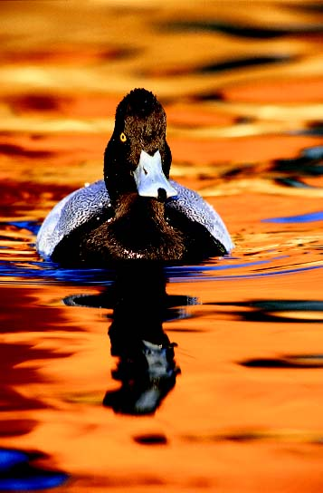

Slide 42
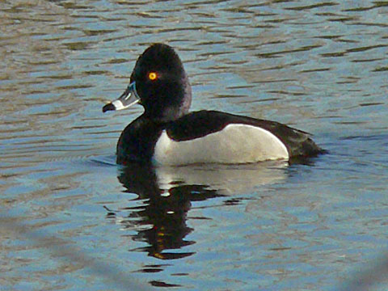
Ring Necked Duck

Slide 43
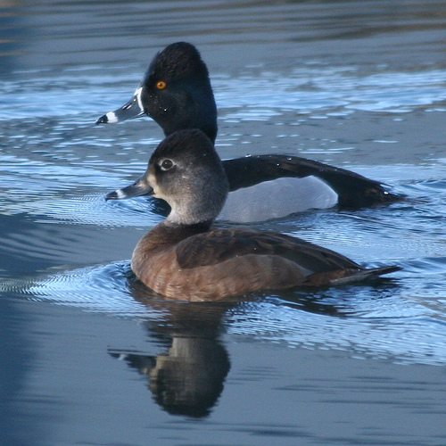

Slide 44
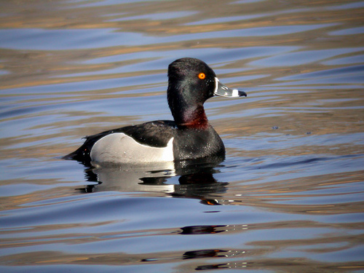
The faint, reddish ring that gave the ring necked duck its name

Slide 45
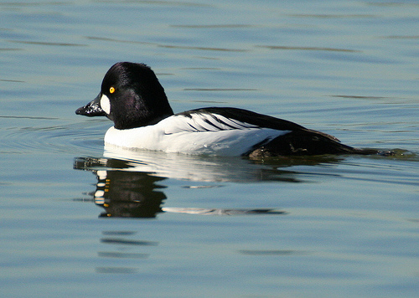
Common Goldeneye

Slide 46
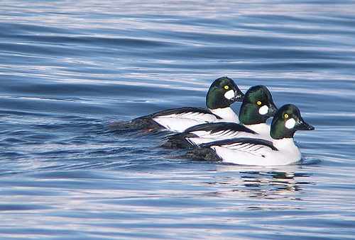

Slide 47
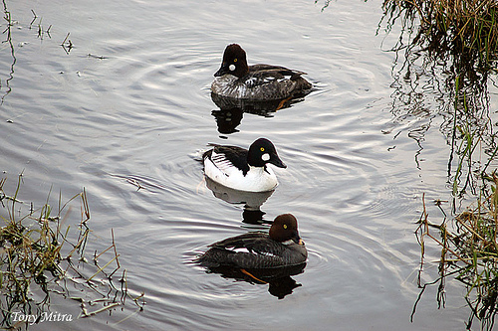

Slide 48
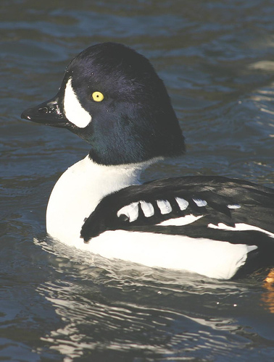
Barrows Goldeneye

Slide 49
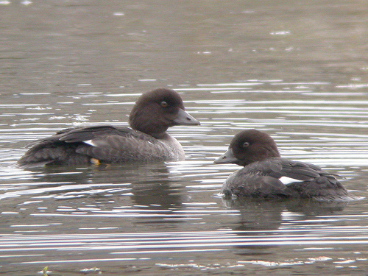

Slide 50
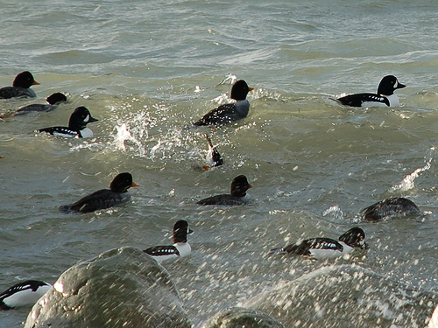

Slide 51
Main distinguishing feature between common and Barrows goldeneye is the shape of the tertiary feathers

Slide 52
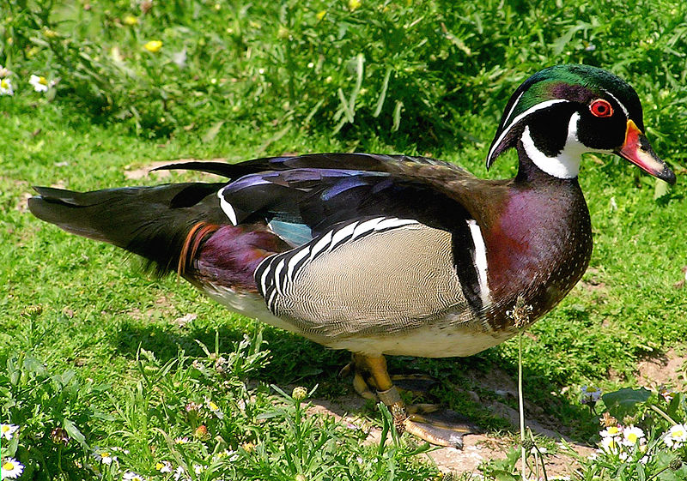
Wood Duck

Slide 53


Slide 54

Ruddy Duck

Slide 55


Slide 56

Known as the “clown prince” of ducks; one of two species of stiff-tailed ducks in North America (other is masked duck)

Slide 57

Harlequin Duck

Slide 58


Slide 59

Builds nests next to moving water; only nesting area in Alberta is in Jasper National Park

Slide 60

Long Tailed Duck

Slide 61


Slide 62


Slide 63

Common Eider

Slide 64


Slide 65


Slide 66

King Eider

Slide 67

Ducks like eiders and scoters often spend most of their time feeding in salt water. They have a de-salination gland for removing the salt from the water that they ingest. It is usually in their nasal cavity.

Slide 68

Surf Scoter

Slide 69


Slide 70

White winged Scoter

Slide 71


Slide 72

Black Scoter

Slide 73


Slide 74

Canada Goose
Families of Canada geese will often join together in groups of young and mature birds called “super broods”. They share the protection of the young. These groups can number as much as 100 birds.

Slide 75


Slide 76


Slide 77


Slide 78

Snow Goose

Slide 79


Slide 80


Slide 81

Blue Goose

Slide 82

Blue geese are a color phase, or variant, of the snow goose

Slide 83

Ross’ Goose

Slide 84

There is a distinct size difference between snows and Ross’ geese. Ross’ are much smaller

Slide 85


Snow geese have a “grinning patch” or raised, tooth-like opening in their bills

Slide 86

White-fronted Goose
Commonly referred to as “speckle bellies”

Slide 87


Slide 88

Trumpeter Swan

Slide 89


Slide 90

Tundra Swan

Slide 91


Slide 92


Slide 94

American Coot

Slide 95

Ugly babies are supposed to be less appetizing to predators

Slide 96

American Avocet

Slide 97


Slide 98

Common Snipe

Slide 99


Slide 100

Willet

Slide 101


Slide 102

Killdeer

Slide 103

Killdeer often fake broken wings to draw predators away from their nests

Slide 104

Sandpiper

Slide 105


